Slide 1
Linear Block Code
Prepared by
Prof. Hitesh Dholakiya
Modified by
Rifat Rahman
Assistant Professor
Institute of Appropriate Technology, BUET
https://rrahman007.buet.ac.bd

Slide 2
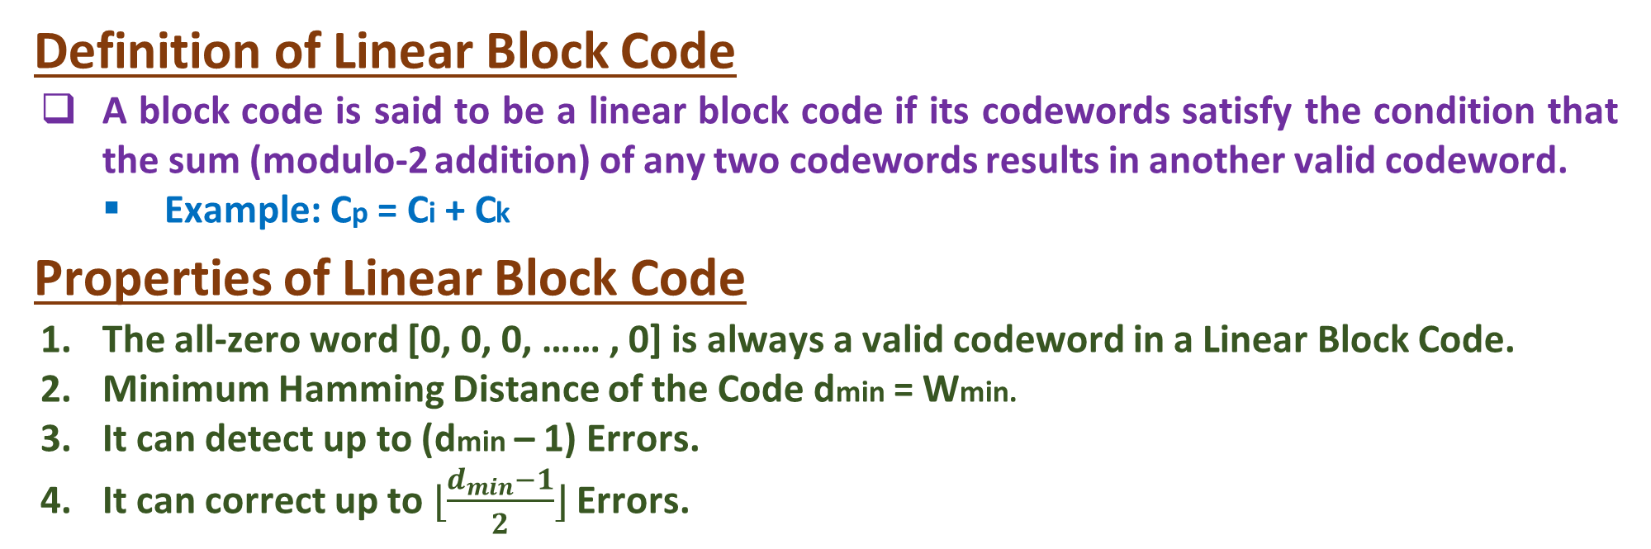
Linear Block Code
Definition of Linear Block Code
A block code is said to be a linear block code if its codewords satisfy the condition that the sum (modulo-2 addition) of any two codewords results in another valid codeword.
Example: Cp = Ci + Ck
Properties of Linear Block Code
The all-zero word [0, 0, 0, …… , 0] is always a valid codeword in a Linear Block Code.
Minimum Hamming Distance of the Code dmin = Wmin.
It can detect up to (dmin – 1) Errors.
It can correct up to$⌊\frac{d_{min}−1}{2}⌋$Errors.

Slide 3
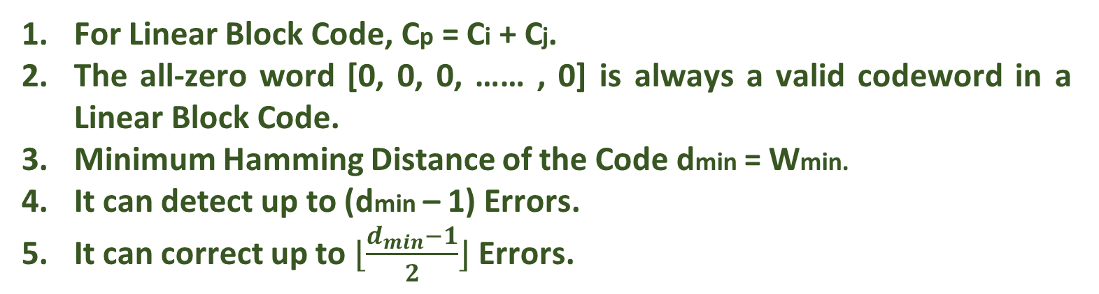
Checking whether Hamming Code is a Linear Block Code
Hamming Code (7,4)
D4 | D3 | D2 | P3 | D1 | P2 | P1
0 | 0 | 0 | 0 | 0 | 0 | 0
0 | 0 | 0 | 0 | 1 | 1 | 1
0 | 0 | 1 | 1 | 0 | 0 | 1
0 | 0 | 1 | 1 | 1 | 1 | 0
0 | 1 | 0 | 1 | 0 | 1 | 0
0 | 1 | 0 | 1 | 1 | 0 | 1
0 | 1 | 1 | 0 | 0 | 1 | 1
0 | 1 | 1 | 0 | 1 | 0 | 0
1 | 0 | 0 | 1 | 0 | 1 | 1
1 | 0 | 0 | 1 | 1 | 0 | 0
1 | 0 | 1 | 0 | 0 | 1 | 0
1 | 0 | 1 | 0 | 1 | 0 | 1
1 | 1 | 0 | 0 | 0 | 0 | 1
1 | 1 | 0 | 0 | 1 | 1 | 0
1 | 1 | 1 | 1 | 0 | 0 | 0
1 | 1 | 1 | 1 | 1 | 1 | 1
For Linear Block Code, Cp = Ci + Cj.
The all-zero word [0, 0, 0, …… , 0] is always a valid codeword in a Linear Block Code.
Minimum Hamming Distance of the Code dmin = Wmin.
It can detect up to (dmin – 1) Errors.
It can correct up to $⌊\frac{d_{min}−1}{2}⌋$ Errors.

Slide 4
Example of Linear Block Code
Example 1: Show that the (4, 3) Even-Parity Code is linear and the (4, 3) Odd-Parity Code is not linear.
(4, 3) Even Parity Block Code (4, 3) Odd Parity Block Code
Data |  |  | Parity
D3 | D2 | D1 | P
0 | 0 | 0 | 0
0 | 0 | 1 | 1
0 | 1 | 0 | 1
0 | 1 | 1 | 0
1 | 0 | 0 | 1
1 | 0 | 1 | 0
1 | 1 | 0 | 0
1 | 1 | 1 | 1
Data |  |  | Parity
D3 | D2 | D1 | P
0 | 0 | 0 | 1
0 | 0 | 1 | 0
0 | 1 | 0 | 0
0 | 1 | 1 | 1
1 | 0 | 0 | 0
1 | 0 | 1 | 1
1 | 1 | 0 | 1
1 | 1 | 1 | 0
Cp = Ci + Ck, It is followed in (4, 3) Even Parity Block Code, but it is not followed in (4, 3) Odd Parity Block Code.

Slide 5
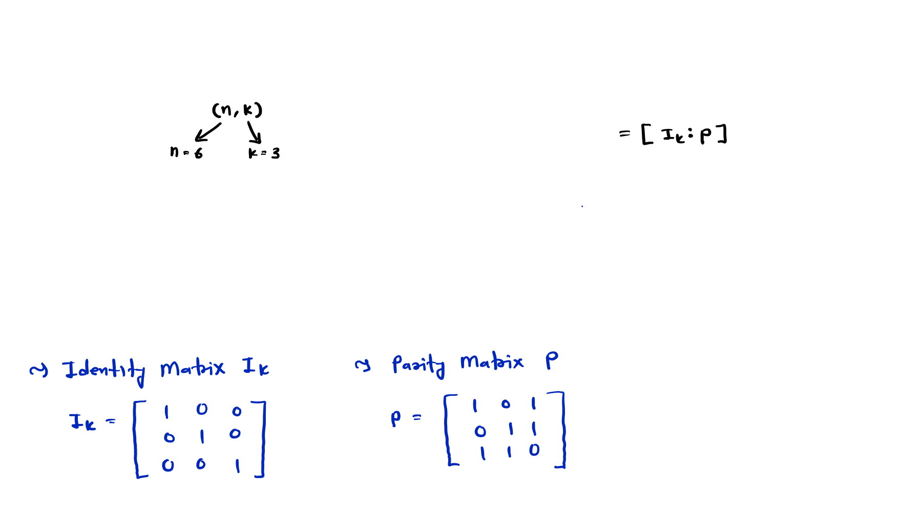
Linear Block Code Solved Example
Example 1: For a (6, 3) code, the Generator Matrix G is given by:
 |  | 𝟏 | 𝟎 | 𝟎 | 𝟏 | 𝟎 | 𝟏
 | ⟹ 𝐆 = | 𝟎 | 𝟏 | 𝟎 | 𝟎 | 𝟏 | 𝟏
Find, |  | 𝟎 | 𝟎 | 𝟏 | 𝟏 | 𝟏 | 𝟎
❑
All Corresponding Code Vectors
Minimum Hamming Distance
Error Detection and Error Correction Capability
Parity Check Matrix
Find error if received code is [1 0 0 0 1 1]

Slide 6
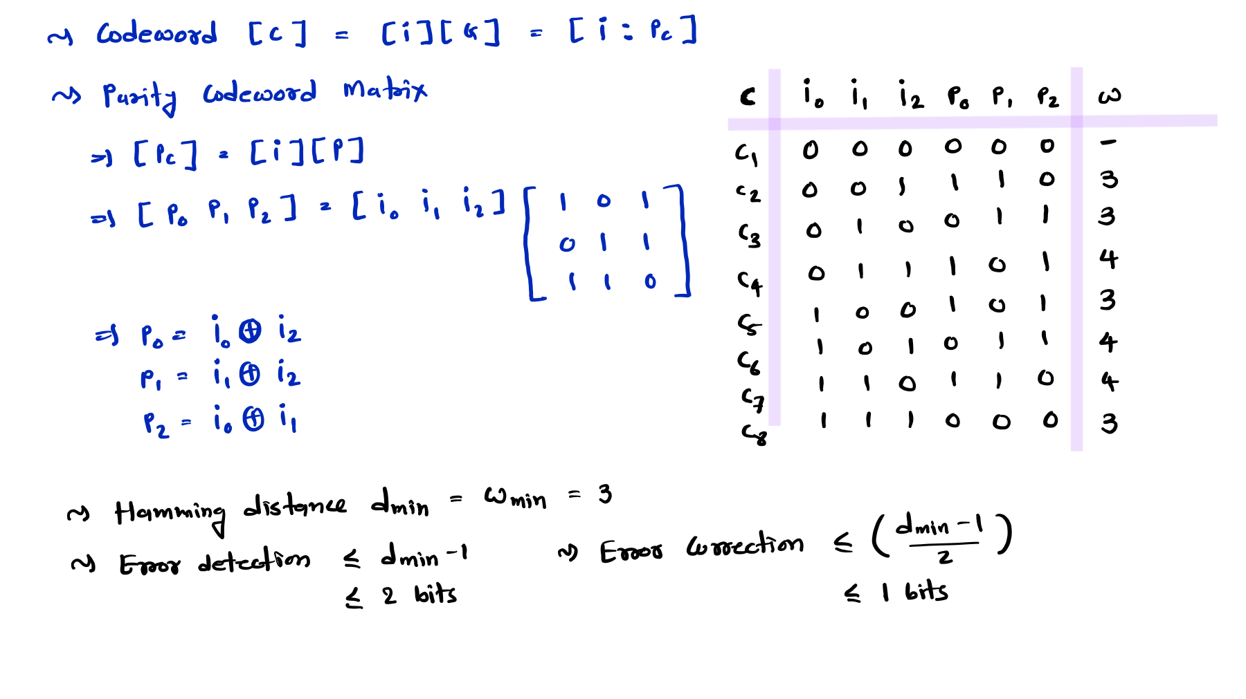
Minimum Hamming Distance

Slide 7
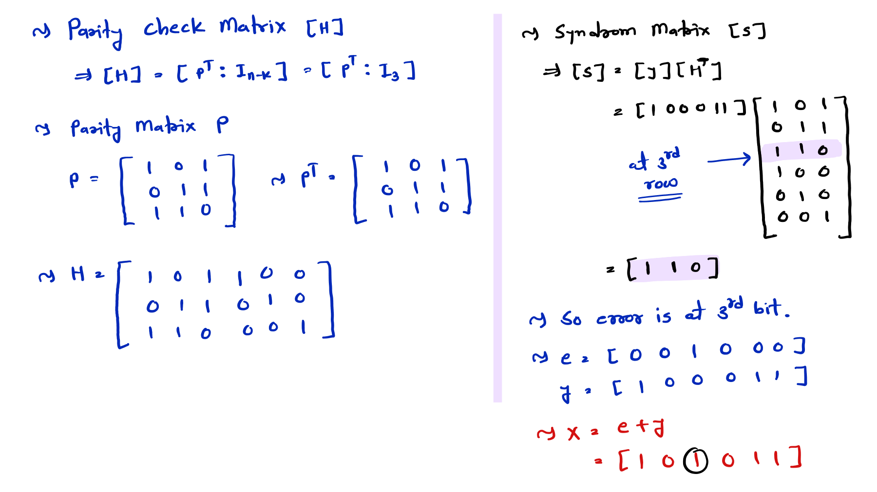

Slide 8
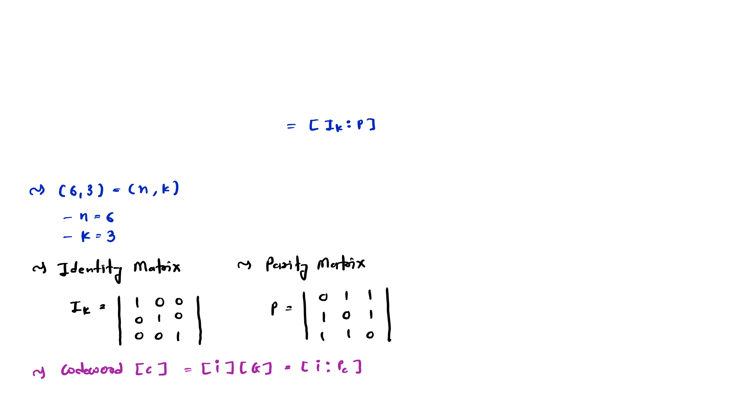
Linear Block Code Solved Examples
Example 2: Determine the set of codewords for a (6, 3) code, the Generator Matrix G is given by:
 | 𝟏 | 𝟎 | 𝟎 | 𝟎 | 𝟏 | 𝟏
⟹ 𝐆 = | 𝟎 | 𝟏 | 𝟎 | 𝟏 | 𝟎 | 𝟏
 | 𝟎 | 𝟎 | 𝟏 | 𝟏 | 𝟏 | 𝟎

Slide 9
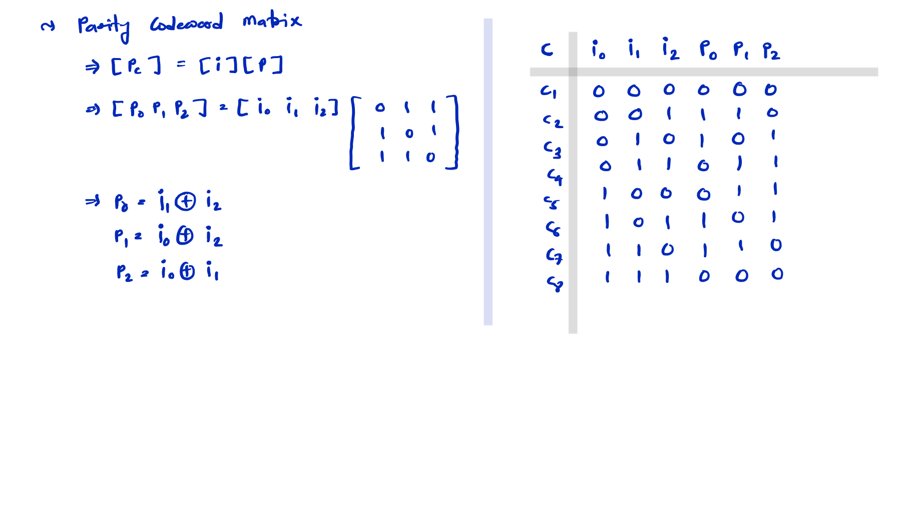

Slide 10
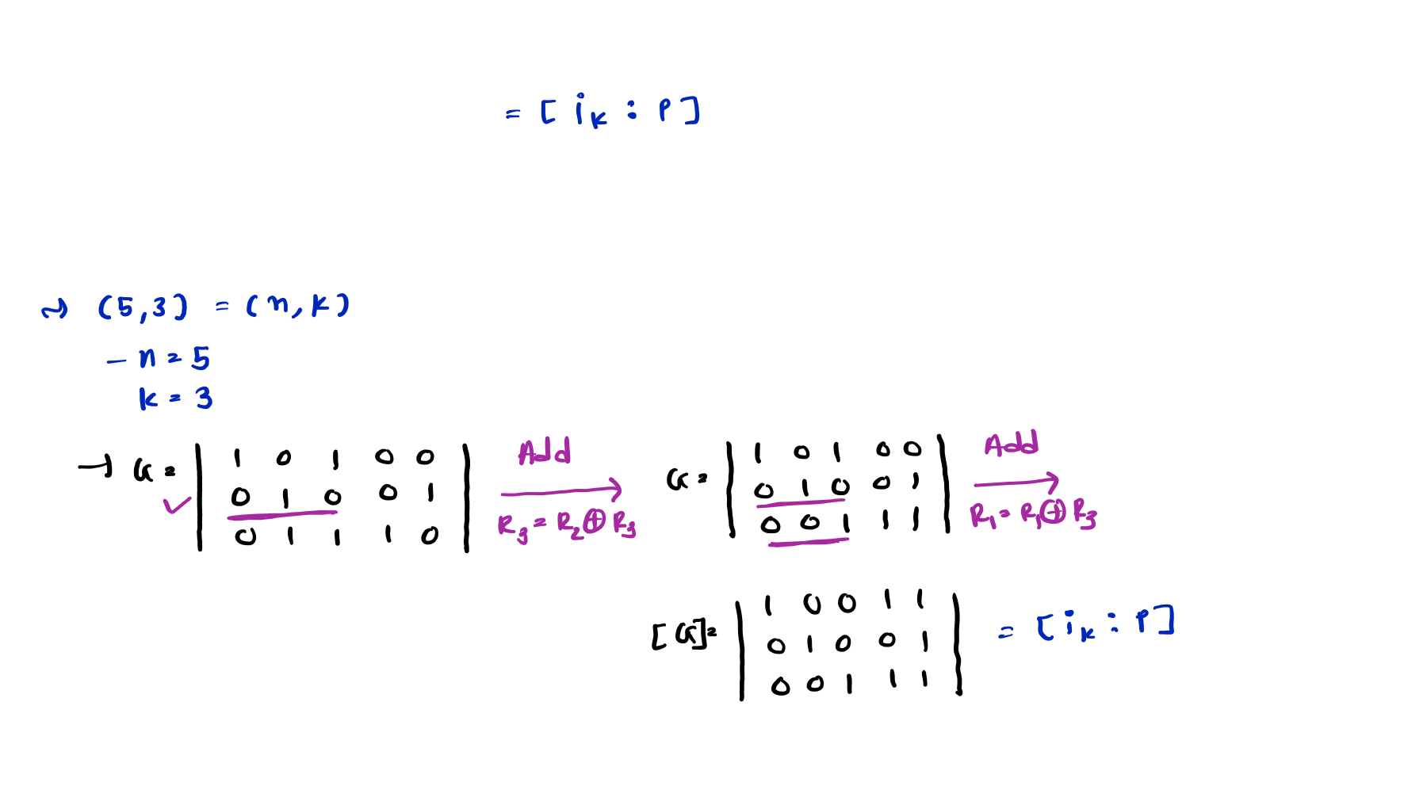
Example 3: The (5, 3) linear code has the generator Matrix G:
𝟏 𝟎 𝟏 𝟎 𝟎
𝟎 𝟏 𝟎 𝟎 𝟏
⟹ 𝐆 =
𝟎 𝟏 𝟏 𝟏 𝟎
Determine Systematic form of G.
Generate Codeword for information [0 1 1] with systematic G and Non-systematic G.

Slide 11
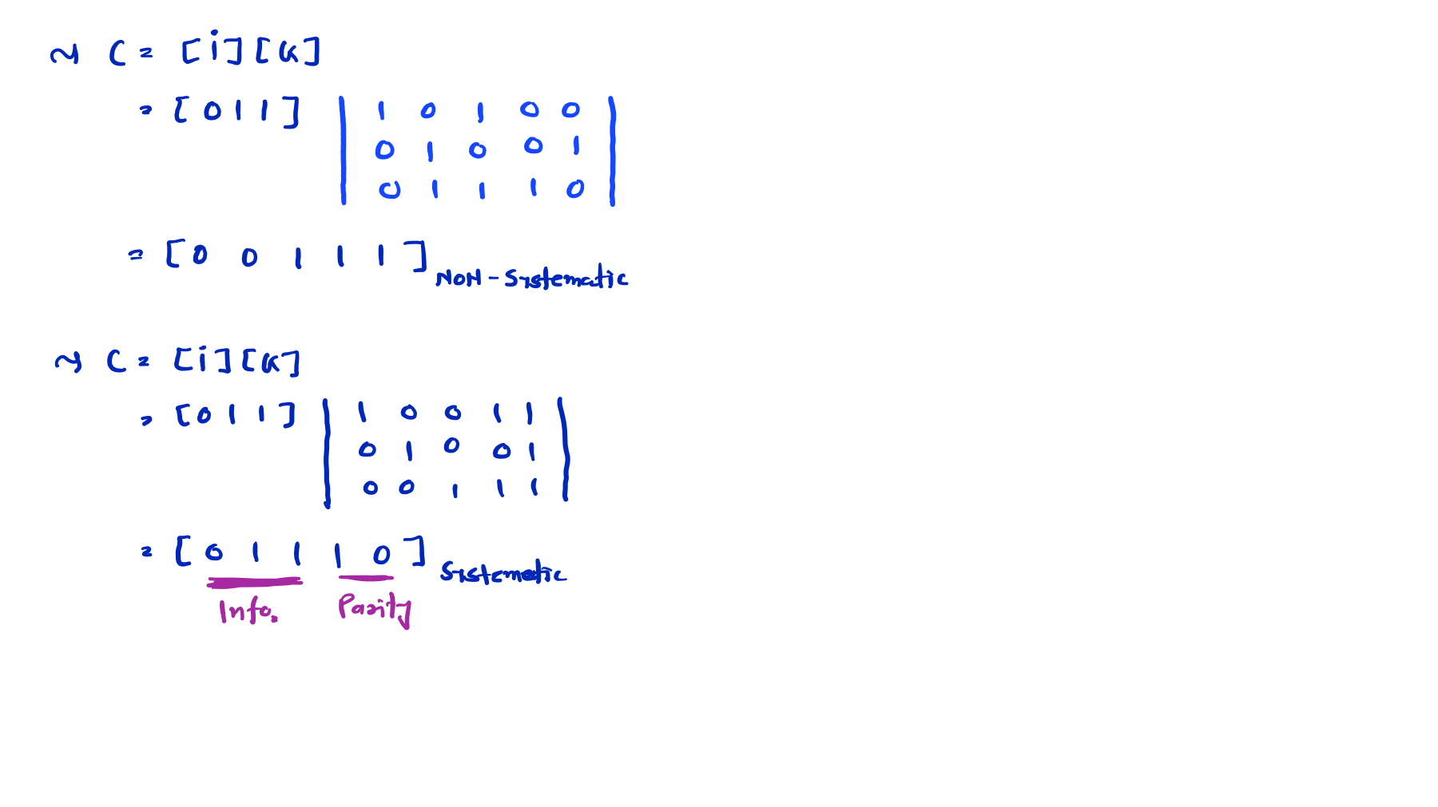

Slide 12
Conversion of Systematic Generator Matrix
In coding theory, transforming a generator matrix through elementary row operations and column swaps has specific impacts on the resulting linear code
Impact of Elementary Row Operations (EROs)
Preserves the Code: EROs do not change the code itself. The set of all possible codewords remains exactly the same because the rows still span the same vector space.
Changes the Basis: It simply provides a different "basis" for the code.
Distance/Weight Properties: The minimum distance (dmin) and weight distribution of the code are completely unaffected.
Encoding Logic: While the code is the same, the mapping between message bits and codewords changes.

Slide 13
Conversion of Systematic Generator Matrix
Impact of Column Swaps
Creates an Equivalent Code: Column swaps do not preserve the exact code; instead, they create a permutationally equivalent code.
Changes the Codewords: The individual codewords change because the positions of the bits are rearranged.
Preserves Fundamental Properties: Even though the codewords look different, the "quality" of the code remains the same:
-The minimum distance (dmin) remains unchanged.
-The error-correcting capability remains identical.
-The weight enumerator (how many words have how many 1s) stays the same.
4. Hardware/Software Impact: Swapping columns requires you to keep track of the new bit order so that the receiver can "un-swap" them to retrieve the original message.

Slide 14
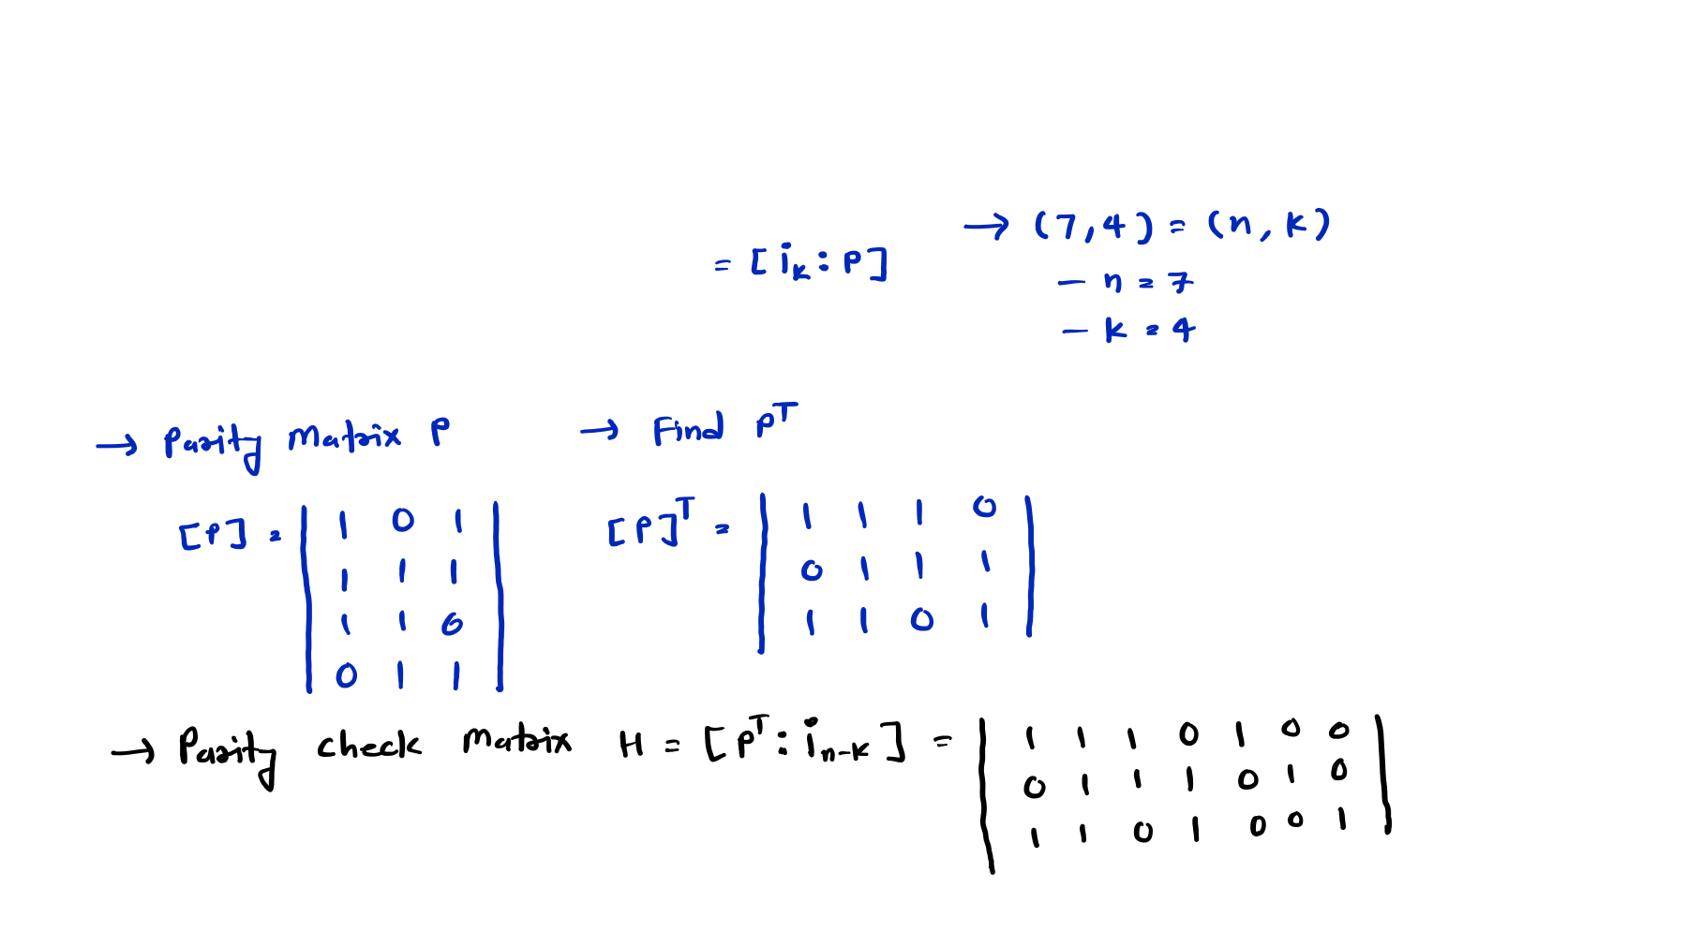
Linear Block Code Solved Examples
Example 4: Determine the parity check Matrix for (7, 4) Generator Matrix G:
⟹ 𝐆 =
𝟏 | 𝟎 | 𝟎 | 𝟎 | 𝟏 | 𝟎 | 𝟏
𝟎 | 𝟏 | 𝟎 | 𝟎 | 𝟏 | 𝟏 | 𝟏
𝟎 | 𝟎 | 𝟏 | 𝟎 | 𝟏 | 𝟏 | 𝟎
𝟎 | 𝟎 | 𝟎 | 𝟏 | 𝟎 | 𝟏 | 𝟏

Slide 15
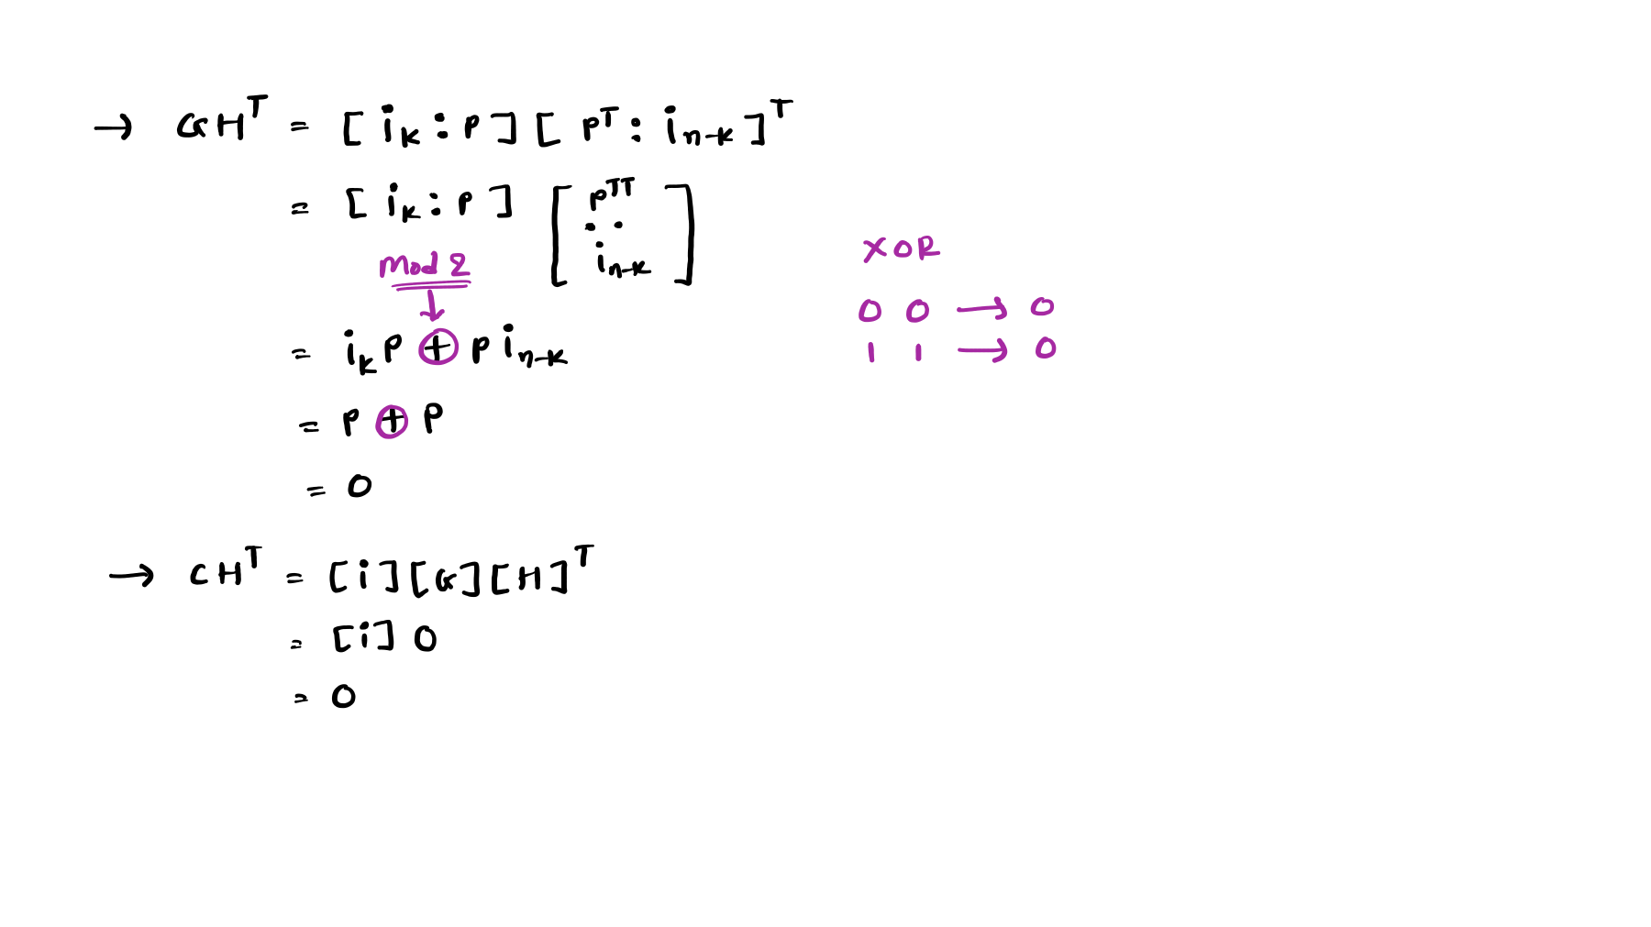
Example 5: Prove that 𝐆𝐇^{𝐓} and 𝐂𝐇^{𝐓} = 𝟎.

Slide 16
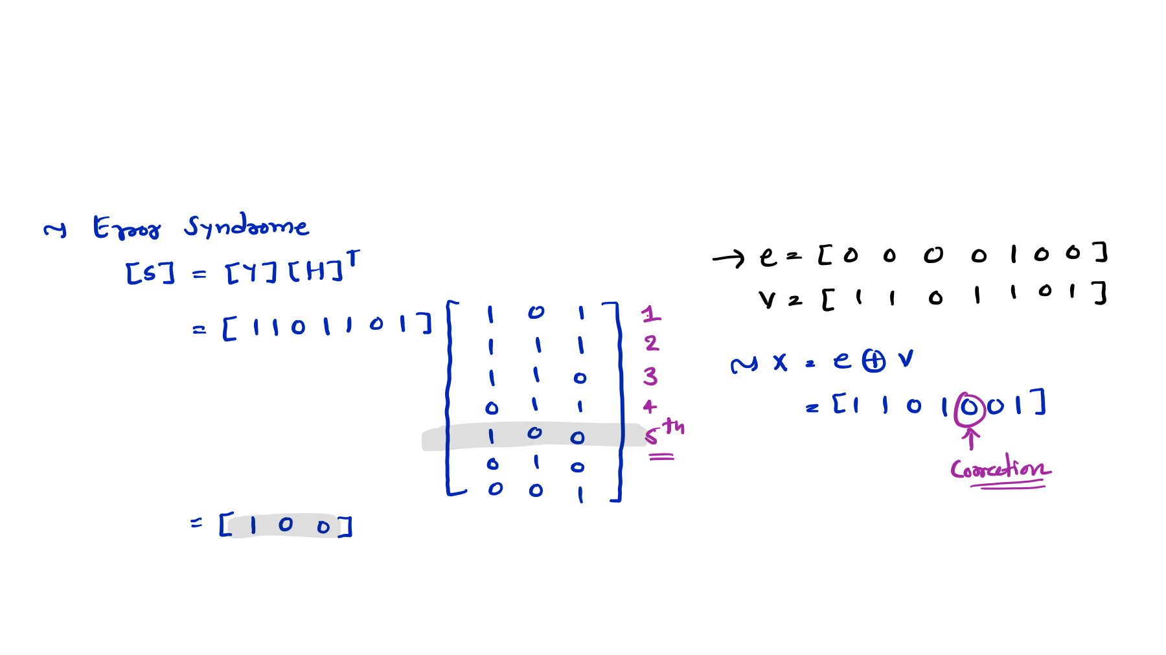
Example 6: Find the Error Syndrome of received codeword V = [1 1 0 1 1 0 1], Also correct the Error. Here Parity Check Matrix is given by:
 | 𝟏 | 𝟏 | 𝟏 | 𝟎 | 𝟏 | 𝟎 | 𝟎
⟹ 𝐇 = | 𝟎 | 𝟏 | 𝟏 | 𝟏 | 𝟎 | 𝟏 | 𝟎
 | 𝟏 | 𝟏 | 𝟎 | 𝟏 | 𝟎 | 𝟎 | 𝟏

Slide 17
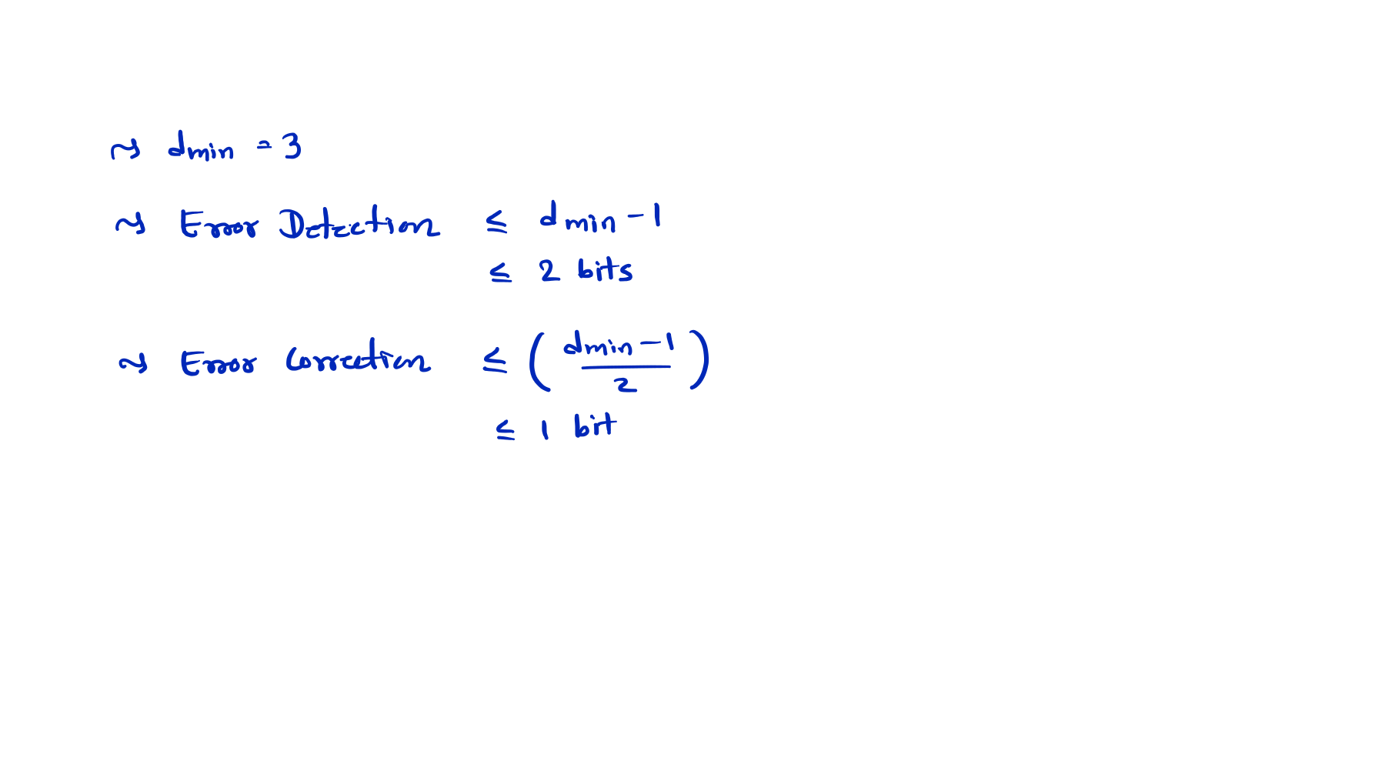
Example 7: If the minimum hamming distance of a linear block code is 3. Find Code error detection and error correction capability.

Slide 18
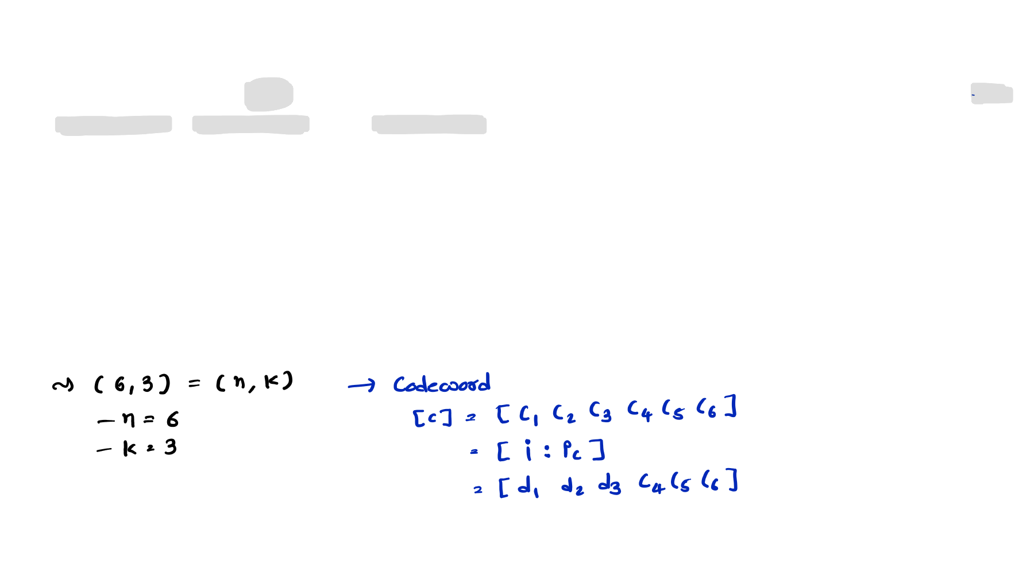
Linear Block Code Solved Example
Example 8: For a (6, 3) Systematic Linear Block code, the three parity check digits are C4 = d1 + d2 + d3, C5 = d1 + d2, and C6 = d1 + d3
Find,
All Corresponding Code Vectors
Minimum Hamming Distance
Error Detection and Error Correction Capability
Generator Matrix
Parity Check Matrix
Find error if received code is [1 0 1 1 0 0]

Slide 19
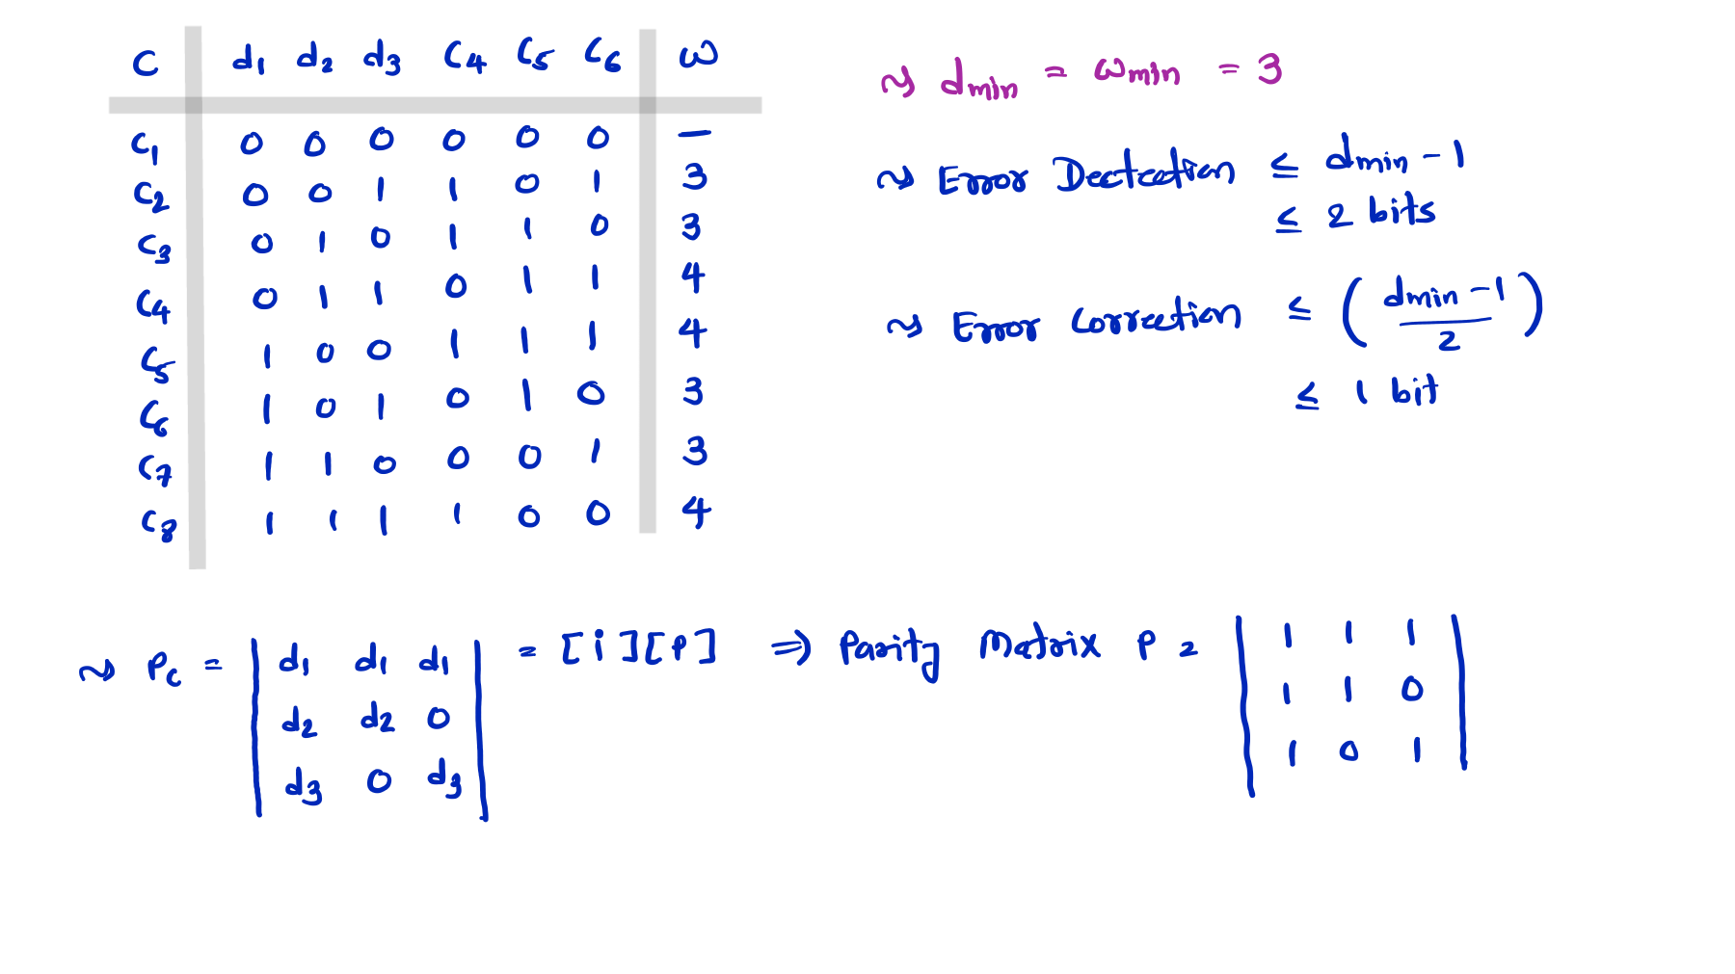

Slide 20
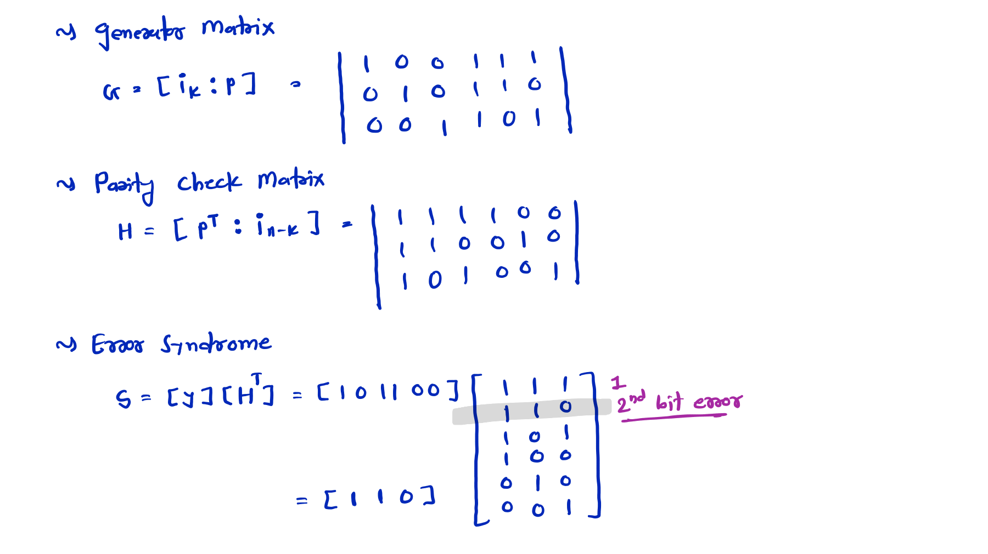

Slide 21
